Slide 1

Announcements
See calendar for latest OH schedule
Complete Homework 0 if you haven’t
Teaching feedback always welcome

Slide 2
Last Time: Introduction and Security Principles
Course Logistics
Security Principles

Slide 3
Today’s Cunning Plan: Cryptography
Introduction to Cryptography
What is cryptography?
Definitions
Three types of cryptography
Building blocks of cryptography
A brief history of cryptography

Slide 4
What is cryptography?

Slide 5
What is cryptography?
Older definition: The study of secure communication over insecure channels
Newer definition: Provide rigorous guarantees on the security of data and computation in the presence of an attacker
Not just confidentiality but also integrity and authenticity (we’ll see these definitions today)
Modern cryptography is heavily based on math
The math is hard
We won’t cover the details. Wikipedia is a great resource
Some system / algorithms are provably secure

Slide 6
Definitions

Slide 7
Meet Alice, Bob, Eve, and Mallory
Alice and Bob: The main characters trying to send messages to each other over an insecure communication channel
Eve: An eavesdropper who can read any data sent over the channel
Mallory: A manipulator who can read and modify any data sent over the channel

Slide 8
Meet Alice, Bob, Eve, and Mallory
We often describe cryptographic problems using a common cast of characters
One scenario:
Alice wants to send a message to Bob.
However, Eve is going to eavesdrop on the communication channel.
How does Alice send the message to Bob without Eve learning about the message?
Another scenario:
Bob wants to send a message to Alice.
However, Mallory is going to tamper with the communication channel.
How does Bob send the message to Alice without Mallory changing the message?
Notes:
Passive attacker versus Active attacker

Slide 9
Three Goals of Cryptography
In cryptography, there are three main properties that we want on our data
Confidentiality: An adversary cannot read our messages.
Integrity: An adversary cannot change our messages without being detected.
Authenticity: I can prove that this message came from the person who claims to have written it.
Integrity and authenticity are closely related properties…
Before I can prove that a message came from a certain person, I have to prove that the message wasn’t changed!
… but they’re not identical properties

Slide 10
Keys
The most basic building block of any cryptographic scheme: The key
We can use the key in our algorithms to secure messages
Two models of keys:
Symmetric key model: Alice and Bob both know the value of the same secret key.
Example: AES encryption
Asymmetric key model: Everybody has two keys, a secret key and a public key.
Example: RSA encryption

Slide 11
Security Principle: Kerckhoff’s Principle
This principle is closely related to Shannon’s Maxim
Don’t use security through obscurity. Assume the attacker knows the system.
Kerckhoff’s principle says:
Cryptosystems should remain secure even when the attacker knows all internal details of the system
The key should be the only thing that must be kept secret
The system should be designed to make it easy to change keys that are leaked (or suspected to be leaked)
If your secrets are leaked, it is usually a lot easier to change the key than to replace every instance of the running software
Our assumption: The attacker knows all the algorithms we use. The only information the attacker is missing is the secret key(s).

Slide 12
Confidentiality
Confidentiality: An adversary cannot read our messages.
Analogy: Locking and unlocking the message
Alice uses the key to lock the message in a box
Alice sends the message (locked in the box) over the insecure channel
Eve sees the locked box, but cannot access the message without the key
Bob receives the message (locked in the box) and uses the key to unlock the message
Alice
Key
Insecure Channel
Key
Bob
Message
Lock
Message in locked box
Unlock
Message

Slide 13
Confidentiality
Schemes provide confidentiality by encrypting messages
Alice uses the key to encrypt the message: Change the message into a scrambled form
Alice sends the encrypted message over the insecure channel
Eve sees the encrypted message, but cannot figure out the original message without the key
Bob receives the encrypted message and uses the key to decrypt the message back into its original form
Alice
Key
Insecure Channel
Key
Bob
Message
Encryption Algorithm
Encrypted Message
Decryption Algorithm
Message

Slide 14
Confidentiality
Plaintext: The original message
Ciphertext: The encrypted message
Alice
Key
Insecure Channel
Key
Bob
Plaintext
Encryption Algorithm
Ciphertext
Decryption Algorithm
Plaintext

Slide 15
Integrity (and Authenticity)
Integrity: An adversary cannot change our messages without being detected.
Analogy: Adding a seal on the message
Alice uses the key to add a special seal on the message (e.g. puts tape on the envelope)
Alice sends the message and the seal over the insecure channel
If Mallory tampers with the message, she’ll break the seal (e.g. break the tape on the envelope)
Without the key, Mallory cannot create her own seal
Bob receives the message and the seal and checks that the seal has not been broken
Alice
Key
Insecure Channel
Key
Bob
Message
Create Seal
Message
Check Seal
Message
Seal

Slide 16
Integrity (and Authenticity)
Schemes provide integrity by adding a tag or signature on messages
Alice uses the key to generate a special tag for the message
Alice sends the message and the tag over the insecure channel
If Mallory tampers with the message, the tag will no longer be valid
Bob receives the message and the tag and checks that the tag is still valid
More on integrity in a future lecture
Alice
Key
Insecure Channel
Key
Bob
Message
Create Tag
Message
Check Tag
Message
Tag

Slide 17
Threat Models (Types of Cryptanalysis)
Ciphertext only
Attackers only have ciphertext, need to decrypt it
Known-plaintext
Attackers know some ciphertext and its corresponding plaintext, needs to decrypt some other cyphertext
Chosen-plaintext
Attackers can get any ciphertext they want encrypted, and need to decrypt some specific cyphertext
In this class, we often use the chosen plaintext attack model
Notes:
Cipher-text
Known plaintext attack:
Chosen plaintext attack: try to get the key or a method to decrypt

Slide 18
Three Types of Crypto

Slide 19
Three Common Types of Crypto
Secret Key Cryptography (Symmetric)
Public Key Cryptography (Asymmetric)
Hashing
Notes:
Cipher-text
Known plaintext attack:
Chosen plaintext attack: try to get the key or a method to decrypt

Slide 20
Secret-Key (Symmetric) Crypto
Both parties share the same key in the communication
The same key is used for encryption and decryption
Alice
Key
Insecure Channel
Key
Bob
Plaintext
Encryption Algorithm
Ciphertext
Decryption Algorithm
Plaintext
Notes:
The symmetric key or secret key cryptography is a cryptographic technique where both parties in the communication share the same key.
In the example we mentioned previously, we have Alice taking her plain text and encrypting it with a secret key to get her ciphertext.
Bob takes that same ciphertext and he decrypts it with the same secret key.
So those two keys are the same and he gets out the original plaintext that Alice encrypted.
So that's basically how symmetric key cryptography works.

Slide 21
Two Types of Symmetric Crypto
Stream Ciphers
Block Ciphers
Notes:
There are two types of symmetric key cryptography: stream ciphers and block ciphers. We're going to talk about both of those.

Slide 22
Stream Ciphers
Use a fixed length key to produce a pseudo-random stream of bits
Same key gets you the same stream
XOR those bits with your PT in order to encrypt
XOR those same bits with your CT in order to decrypt
Tries to approximate one-time-pad
Notes:
Stream ciphers are a type of symmetric key crypto and they use a fixed length key to produce what's called a pseudo-random stream of bits and what that means is you put in a fixed length key and this algorithm just produces a string of ones and zeros seemingly random but anytime you use the same key into the algorithm you get out that same stream of ones and zeros.
In order to encrypt or decrypt you just use the XOR exclusive or operator to exclusive or those bits with your plaintext in order to encrypt and you exclusive are those same bits in order to decrypt so it works the same way other way whether you encrypting or decrypting you're just exclusive oaring your message with the bits from the bit stream the goal of a stream cipher is to approximate a one-time pad.
so when we discussed a one-time pad I mentioned that it was the only provably secure form of cryptography which is where your key is just as long as your message well a stream cipher has the goal to approximate that but instead of using a key that's as long as a message you use a much smaller key and then that Keys used to generate a very very very long stream of bits.

Slide 23
Notes:
Let's look at some two Real-Word Stream Ciphers real-world stream ciphers the first is called RC 4 RC 4 was a stream cipher that's most famously used in WEP the wireless equivalent protocol or wired equivalent protocol for wireless network security it's also an option in TLS or HTTPS for encrypting web traffic but it's not recommended for use anymore it has some mathematical weaknesses that mean it's May it's not suitable for quite a few applications another real-world stream cipher is a 5-1 and this is used for encrypting GSM phone data and conversations and so it's used to encrypt data before your phone sends it wirelessly to the to the operator the NSA is known to routinely break a 5/1 this was released as part of the Snowden leaks so again it's another stream cipher that's not really recommended for for usage so let's do a stream cipher Stream Cipher Encryption Example encryption example so let's say we have some plaintext data that we want to encrypt and we have a key that we're going to use in this case I'll just make it 128 bits we take that key and we feed it into our stream cipher which in this case is our c4 and that causes our c4 to produce key stream which is a potentially infinitely long string of ones and zeros but we produce enough key stream so that we have the same length of key stream as we do plaintext data and then we exclusive-or those two things together in order to get our cipher text so the key stream exclusive board with the plaintext gets me the ciphertext so I could write that as ciphertext equals the key stream exclusive Ord with the plaintext well how do i decrypt decryption is very similar except in this case I have ciphertext that I want to decrypt and I take that same key that was used to encrypt it I put the key into rc4 I get out the same key stream that the person who encrypted got and when I exclusive-or the key stream and the ciphertext together I get the plaintext another way to write that would be to simply say that plaintext equals key stream exclusive Ord with ciphertext so let's look at that a Using XOR with a Stream Cipher little bit more about how we use exclusive or with a stream cipher now when we use exclusive or for encryption we see that the ciphertext equals the plaintext exclusive Ord with the key stream which is just what we went over when we use it for decryption the plaintext equals the cipher text exclusive Ord with the key stream so basically whether you're encrypting or decrypting you simply take the message you're working with and you exclusive-or with the key stream and that performs the encryption or the decryption operation let's look at an example so if XOR Example I'm going to do an encryption now my plaintext is here oh 0 1 1 0 and my key stream is 1 1 0 1 I'm going to exclusive-or them together to get the cipher text now in case you're not familiar with exclusive or are you've forgotten because it's been a long time since you looked at it here's the truth table for exclusive or and what this shows is that if we exclusive or 1 together with 1 we get 0 1 exclusive o'red of 0 is 1 0 exclusive o'red with 1 is 1 and 0 exclusive o'red of 0 is 0 it's just the truth table for exclusive or so if I look here and I see that the plaintext is 0 1 1 0 the key stream is 1 1 0 1 when I do the exclusive or I'm just going to do a bitwise so 0 exclusive o'red with 1 is 1 1 exclusive ward with 1 is 0 so I have 1 0 1 exclusive ward with 0 is 1 and 0 exclusive o'red of 0 is 0 so my ciphertext is 1 0 1 0 if I go to decrypt then so if I decrypt that ciphertext using the exact same key stream then I'm just going to exclusive or those together again so 1 exclusive ward with 1 is 0 0 exclusive o'red with 1 is 1 1 exclusive o'red with 0 is 1 and 0 squared of 0 is 0 so I get that result to be 0 1 1 0 and they match so you can see up here that the original plaintext I started with matches the plaintext I get at the end 1 decrypt so I encrypt by exclusive warring with the key stream and I decrypt by exclusive warring with that same key stream so that was stream Intro to Block Ciphers ciphers now we also want to look at something called block ciphers now block ciphers are another type of symmetric key crypto and what they do is they use a fixed length key to encrypt a fixed length block of data so a stream cipher generated key stream and you exclusive o'red that together a block cipher encrypts specific blocks fixed length chunks of data into the into an ciphertext of the exact same length so for example a 64-bit block of data and a 128-bit key could be the parameters for a block cipher so I could have a block cipher where my key is 128 bits and I encrypt 64 bits of data at a time now at its core a block cipher is in some ways very similar to a substitution cipher but with a much larger alphabet so remember in a substitution cipher we simply had every letter written out as one entry in a table and then we randomly permuted the entries so that the so that the encrypted version was just a randomized list of the alphabet so that meant that every letter in the plaintext had a one-to-one correspondence with a letter in the ciphertext well the block cipher is basically the same thing except our alphabet size is a lot bigger instead of it just being 26 letters it's every possible say 64 bit value so if we were to do a 64 bit block cipher that would mean that our substitution table would have 2 to the 64 entries which is 1.8 times 10 to 19 that's a huge number that would be a really big substitution table in fact it would be a hundred and 25 million terabytes so it's huge so I don't give this example to say that this is how a block cipher works it doesn't build an actual table but the idea is the same in concept every 64 bits of plaintext would have a corresponding cipher text for a given key so my goal of a block cipher is to do this same thing but do it with an algorithm and a small key instead of building up an enormous table Real-World Block Ciphers so some real-world block cyphers will go over two of them the first is the data encryption standard des des is a was a US government standard until 2001 it was released in 1976 and it uses a 64-bit block size in a 56 bit key size so the key was 56 bits but the blocks of data that you encrypt are 64 bits now a DES was replaced by AES the advanced encryption standard an aes uses a 128-bit block size and it can take a variety of key sizes either 128 192 or 256 bits for the key size AES is the current US government standard and it's it's probably the most widely used symmetric key algorithm in in most applications today and it's considered very secure lots of smart people have looked at it and they haven't found any significant weaknesses let's do a Simplified AES Example simplified AES example so in this case my encryption I take some plaintext data of one block size so if we're doing a EES that block size the hutt is 128 bits I take a key which is 256 bits for AES here and I run it through the AES encryption algorithm so the key and the data go in together and that produces ciphertext data of 128 bits so my plaintext block is converted to a ciphertext block of the same size and when I decrypt I do the same thing in Reverse I put my ciphertext and the key into the AES decryption algorithm and I get out the plaintext data now it's really important to note a couple of things here first is that the block size is really important you can't use a block cipher to encrypt something that's smaller or larger than the block size you can only encrypt an item that is exactly that size so if your item is smaller than in this case 128 bits you would need to break it up into pieces and encrypt each piece separately if your item is bigger than the block size in this case 128 bits then you need to break it up into smaller pieces and encrypt each 128-bit piece separately if your item is smaller than 128 bits then you need to add some junk we call it padding just add some extra bits to get it up to the right size because a block cipher only encrypts chunks of data that are the right size blocks so let's look at some properties Properties of Block Ciphers of block ciphers now one important property is that the plaintext two ciphertext mappings must be one-to-one for a given key so that means that for a given key the same plaintext block always becomes the same ciphertext block and the same ciphertext block always becomes the same plaintext block so vice-versa it's also really important that the input and output have no correlation so what this means is if I have a 128-bit input block that will produce an output block if I change one bit of that input block then the output block should change significantly in a way that's not distinguishable from random and not distinguishable from random it's just a big fancy way to say that about 50% of the bit should change so if I change one bit on the input then about 50% of the output bits should change so get some features of block Features of Block Ciphers ciphers the first is the block size in general the bigger the block size the more secure it is to an extent but it's probably slower larger block sizes tend to be a little bit slower when you do the encryption in the decryption and key size is the same in general bigger is more secure but it's probably slower because it takes more computations to do the encryption okay so let's summarize this discussion Summing Up of block ciphers and stream ciphers stream ciphers are used to produce a pseudo-random stream of bits that you exclusive or with your plaintext so the stream cipher produces the stream of bits your ki stream and you exclusive or that with your plaintext to encrypt or you exclusive for it with your ciphertext to decrypt block ciphers are used to encrypt one data block or used to encrypt data one block at a time so you put in one block of plaintext you get out one block of ciphertext and in all of the symmetric key ciphers that we've talked about today the sender and receiver need to share the same key

Slide 24
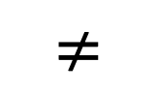
Public-Key (Asymmetric) Crypto
Both parties use different key in the communication
Everyone has two keys: a private key and a public key
The two keys are mathematically related, it’s almost impossible to get private key from public key
Public key for encryption
Private key for decryption
Alice
Bob’s Public Key
Insecure Channel
$$≠$$
Bob
Bob’s Private Key
Bob’s Public Key
Plaintext
Encryption Algorithm
Ciphertext
Decryption Algorithm
Plaintext

Slide 25
Hashing
Both parties share the same key in the communication
The same key is used for encryption and decryption
Alice
Key
Insecure Channel
Key
Bob
Plaintext
Encryption Algorithm
Ciphertext
Decryption Algorithm
Plaintext

Slide 26
Building Blocks of Cryptography

Slide 27
Cryptography Roadmap
 | Symmetric-key | Asymmetric-key
Confidentiality | One-time pads Stream ciphers Block ciphers | RSA encryption
Integrity, Authentication | MACs (e.g. HMAC) | Digital signatures (e.g. RSA signatures)
Hash functions
Pseudorandom number generators
Public key exchange (e.g. Diffie-Hellman)
Key management (certificates)
Password management

Slide 28
Building Blocks
There are hundreds of security related protocols. Fortunately, only a limited number of building blocks are involved
If secure blocks are put together in a wrong way, the final protocols may be insecure
How to organize these blocks shows the skills of the researchers
Notes:
Cipher-text
Known plaintext attack:
Chosen plaintext attack: try to get the key or a method to decrypt

Slide 29
Block 1: One Way Functions
One way function is easy to calculate in one direction, but not the other.
Given x, easy to get f(x)
Given f(x), even f() is known, still not easy to get a x that satisfies f(x)
Think about the fingerprint of a person
Trap door one way function
Given x, easy to calculate f(x)
Given f(x), difficult to get x
Given f(x) and a secret y, easy to recover x
Think about asymmetric encryption

Slide 30
Block 1: One Way Hash Function
Map a variable-length input string to a fixed length string: fingerprint the file
Easy to get Hash(x) when giving x
Almost impossible to find a x that satisfies Hash(x)
Almost impossible to find two files x and x’ to have the same hash value
Minor change in x, large changes in Hash(x)
Since the hash value is shorter, we have conflict:
We can easily rule out files, but cannot guarantee this is the origin file
Still good enough in courts, like DNA tests

Slide 31
Block 1: One Way Hash Function
Usage of hash function
Timestamp a file and prove that you are the creator (can be used to timestamp the homework)
Hash values of the downloaded files
A commitment that cannot be easily changed
Verify the integrity of the files in a file system
Security problems: how and where to save the hash values
Use a secret key k, do not store k on the computer, use Hash(x, k) to prevent change on the computer: usually called MAC code (message authentication code)

Slide 32
Block 2: Symmetric Cryptography
Steps:
(1) Alice and Bob agree on a key k and an encryption algorithm
(2) Alice calculates E_k (message) and sends the cipher text to Bob
(3) Bob decrypts the message and gets the plaintext
Problems
How to determine the key: must in a secret place
How to convince other people it is from Alice instead of Bob
Number of keys increases fast, not scalable

Slide 33
Block 3: Asymmetric Cryptography
First appeared in 1976, proposed by Diffie and Hellman
Two keys: public key and private key, it is almost impossible to get private key from public key.
A certain kind of trap door one way functions: private key is the secret
Steps:
Alice and Bob agree on a public key encryption algorithm
Bob sends his public key to Alice
Alice calculates E_pubB (message) and sends the cipher text to Bob
Bob decrypts the message with the private key and gets the plaintext

Slide 34
Block 3: Asymmetric Cryptography (continue)
Solve the problem in symmetric crypto methods: the key can be transferred in public
More scalable, easy for multicast
New problems:
How can we make sure it is Bob’s public key
Trusted Third Party
Certificate for the public key
How to guarantee the sender’s identity

Slide 35
Hybrid Crypto Systems
Symmetric methods are fast, easy to implement, but require special attention during key distribution
Asymmetric methods are slow, but more secure
Hybrid:
Using asymmetric method to distribute key
Using symmetric method to encrypt data

Slide 36
Using Hybrid Crypto Systems
Steps
Bob sends Alice his public key
Alice encrypts the session key with this public key and sends to Bob
Both Alice and Bob know the session key and can use it for data traffic
Open question: why should B trust A’s capabilities to generate keys?

Slide 37
Merkle’s Puzzle
Make the life of an eavesdropper difficult
The receiver can randomly choose one message
The eavesdropper has to try almost all of them

Slide 38
Block 4: Digital signature
Signature by symmetric encryption:
TTP will get involved
Who should store the encrypted messages?
How to send to a third party: through TTP again
Signature with asymmetric encryption
Using the private key for signature
If the signature is like “I owe Bob $100”, a timestamp should also be included in the signature to avoid replay attack.

Slide 39
Block 5: Random number
Pseudo random numbers:
Usually will repeat after a long sequence
Must long enough
Real random numbers:
Lava lamp
Earthquake strength or interval

Slide 40
Dual encryption
Let’s assume that everyone in the network has a public-private key pair. Alice wants to send a message to Bob and convince that it is from Alice.
For security communication, i.e., confidentiality and integrity, what shall we do?

Slide 41
Dual encryption
Answer:
Alice should first sign the message with her private key, then use Bob’s public key to encrypt the packet
Reason 1: If Alice’s private key is the outer layer, everyone with Alice’s public key will be able to decrypt it.
Reason 2: never sign a random string that you do not know what it is.
Two pair of public-private keys for everyone: one for encryption, one for digital signature

Slide 42
Symmetric-Key Encryption

Slide 43
Symmetric-Key Encryption
The next few schemes are symmetric-key encryption schemes
Encryption schemes aim to provide confidentiality (but not integrity or authentication)
Symmetric-key means Alice and Bob share the same secret key that the attacker doesn’t know
Don’t worry about how Alice and Bob share the key for now
For modern schemes, we’re going to assume that messages are bitstrings
Bitstring: A sequence of bits (0 or 1), e.g. 11010101001001010
Text, images, etc. can usually be converted into bitstrings before encryption, so bitstrings are a useful abstraction. After all, everything in a computer is just a sequence of bits!

Slide 44
Symmetric-Key Encryption: Definition
A symmetric-key encryption scheme has three algorithms:
KeyGen() → K: Generate a key K
Enc(K, M) → C: Encrypt a plaintext M using the key K to produce ciphertext C
Dec(K, C) → M: Decrypt a ciphertext C using the key K
Alice
Key
Insecure Channel
Key
Bob
Plaintext
Encryption Algorithm
Ciphertext
Decryption Algorithm
Plaintext

Slide 45
Symmetric-Key Encryption: Definition
What properties do we want from a symmetric encryption scheme?
Correctness: Decrypting a ciphertext should result in the message that was originally encrypted
Dec(K, Enc(K, M)) = M for all K ← KeyGen() and M
Efficiency: Encryption/decryption algorithms should be fast: >1 Gbps on a standard computer
Security: Confidentiality
Alice
Key
Insecure Channel
Key
Bob
Plaintext
Encryption Algorithm
Ciphertext
Decryption Algorithm
Plaintext

Slide 46
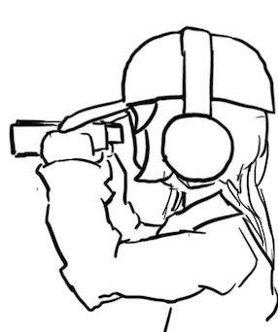
Defining Confidentiality
Recall our definition of confidentiality from earlier: “An adversary cannot read our messages”
This definition isn’t very specific
What if Eve can read the first half of Alice’s message, but not the second half?
What if Eve figures out that Alice’s message starts with “Dear Bob”?
This definition doesn’t account for prior knowledge
What if Eve already knew that Alice’s message ends in “Sincerely, Alice”?
What if Eve knows that Alice’s message is “BUY!” or “SELL” but doesn't know which?

Slide 47
Defining Confidentiality
A better definition of confidentiality: The ciphertext should not give the attacker any additional information about the plaintext.
Let's design an experiment/security game to test our definition:
Eve chooses two messages M0 and M1 of the same length
Alice chooses one message at random Mb, encrypts it, and sends the ciphertext
Eve knows either M0 or M1 was sent, but doesn't know which
Eve reads the ciphertext and tries to guess which message was sent
If the probability that Eve correctly guesses which message was sent is 1/2, then the encryption scheme is confidential
Intuition
If the scheme is confidential, Eve can only guess with probability 1/2, which is no different than if Eve hadn’t sent the ciphertext at all
In other words: the ciphertext gave Eve no additional information about which plaintext was sent!
Notes:
Shafi and Silvio won 2012 Turing award for probabilistic encryption, proving the need for randomization, laying foundations for modern cryptography and much stronger guarantees

Slide 48
Defining Confidentiality: (Continue)
Recall our threat model: Eve can also perform a chosen plaintext attack
Eve can trick Alice into encrypting arbitrary messages of Eve's choice
We can adapt our experiment to account for this threat model
A better definition of confidentiality: Even if Eve is able to trick Alice into encrypting messages, Eve can still only guess what message Alice sent with probability 1/2.
This definition is called IND-CPA (indistinguishability under chosen plaintext attack)
Cryptographic properties are often defined in terms of “games” that an adversary can either “win” or “lose”
We will use one to define confidentiality precisely

Slide 49
One-Time Pads

Slide 50
Cryptography Roadmap
 | Symmetric-key | Asymmetric-key
Confidentiality | One-time pads Block ciphers with chaining modes (e.g. AES-CBC) Stream ciphers | RSA encryption
Integrity, Authentication | MACs (e.g. HMAC) | Digital signatures (e.g. RSA signatures)
Hash functions
Pseudorandom number generators
Public key exchange (e.g. Diffie-Hellman)
Key management (certificates)
Password management

Slide 51
Review: XOR
The XOR operator takes two bits and outputs one bit:
Useful properties of XOR:
0 ⊕ 0 = 0
0 ⊕ 1 = 1
1 ⊕ 0 = 1
1 ⊕ 1 = 0
x ⊕ 0 = x
x ⊕ x = 0
x ⊕ y = y ⊕ x
(x ⊕ y) ⊕ z = x ⊕ (y ⊕ z)
(x ⊕ y) ⊕ x = y

Slide 52
Review: XOR Algebra
Algebra works on XOR too
y ⊕ 1 = 0 | Goal: Solve for y
y ⊕ 1 ⊕ 1 = 0 ⊕ 1 | XOR both sides by 1
y = 1 | Simplify with identities

Slide 53
One-Time Pads: Key Generation
Alice
K
0 | 1 | 1 | 0 | 0 | 1 | 0 | 1 | 0 | 1 | 1 | 1
The key K is a randomly-chosen bitstring.
Recall: We are in the symmetric-key setting, so we’ll assume Alice and Bob both know this key.

Slide 54
One-Time Pads: Encryption
Alice
K
0 | 1 | 1 | 0 | 0 | 1 | 0 | 1 | 0 | 1 | 1 | 1
M
1 | 0 | 0 | 1 | 1 | 0 | 0 | 1 | 0 | 1 | 0 | 0
The plaintext M is the bitstring that Alice wants to encrypt.
Idea: Use XOR to scramble up M with the bits of K.

Slide 55
One-Time Pads: Encryption
Alice
K
0 | 1 | 1 | 0 | 0 | 1 | 0 | 1 | 0 | 1 | 1 | 1
⊕ | ⊕ | ⊕ | ⊕ | ⊕ | ⊕ | ⊕ | ⊕ | ⊕ | ⊕ | ⊕ | ⊕
M
1 | 0 | 0 | 1 | 1 | 0 | 0 | 1 | 0 | 1 | 0 | 0
↓ | ↓ | ↓ | ↓ | ↓ | ↓ | ↓ | ↓ | ↓ | ↓ | ↓ | ↓
C
1 | 1 | 1 | 1 | 1 | 1 | 0 | 0 | 0 | 0 | 1 | 1
Encryption algorithm: XOR each bit of K with the matching bit in M.
The ciphertext C is the encrypted bitstring that Alice sends to Bob over the insecure channel.

Slide 56
One-Time Pads: Decryption
Bob
K
0 | 1 | 1 | 0 | 0 | 1 | 0 | 1 | 0 | 1 | 1 | 1
C
1 | 1 | 1 | 1 | 1 | 1 | 0 | 0 | 0 | 0 | 1 | 1
Bob receives the ciphertext C. Bob knows the key K. How does Bob recover M?

Slide 57
One-Time Pads: Decryption
Bob
K
0 | 1 | 1 | 0 | 0 | 1 | 0 | 1 | 0 | 1 | 1 | 1
⊕ | ⊕ | ⊕ | ⊕ | ⊕ | ⊕ | ⊕ | ⊕ | ⊕ | ⊕ | ⊕ | ⊕
C
1 | 1 | 1 | 1 | 1 | 1 | 0 | 0 | 0 | 0 | 1 | 1
↓ | ↓ | ↓ | ↓ | ↓ | ↓ | ↓ | ↓ | ↓ | ↓ | ↓ | ↓
M
1 | 0 | 0 | 1 | 1 | 0 | 0 | 1 | 0 | 1 | 0 | 0
Decryption algorithm: XOR each bit of K with the matching bit in C.

Slide 58
One-Time Pad
KeyGen()
Randomly generate an n-bit key, where n is the length of your message
Recall: For today, we assume that Alice and Bob can securely share this key
For one-time pads, we generate a new key for every message
Enc(K, M) = K ⊕ M
Bitwise XOR M and K to produce C
In other words: XOR the ith bit of the plaintext with the ith bit of the key.
Ci = Ki ⊕ Mi
Alice and Bob use a different key for each encryption (this is the “one-time” in one-time pad).
Dec(K, C) = K ⊕ C
Bitwise XOR C and K to produce M
Mi = Ki ⊕ Ci
Notes:
Ask students if they can produce the decryption equation before showing it to them

Slide 59
One-Time Pad: Correctness
Correctness: If we encrypt and then decrypt, we should get the original message back
Enc(K, M) | = | K ⊕ M | Definition of encryption
Dec(K, Enc(K, M)) | = | Dec(K, K ⊕ M) | Decrypting the ciphertext
 | = | K ⊕ (K ⊕ M) | Definition of decryption
 | = | M | XOR property

Slide 60
One-Time Pad: Security
Recall our definition of confidentiality: The ciphertext should not give the attacker any additional information about the plaintext
Recall our experiment to test confidentiality from earlier:
Alice has encrypted and sent either M0 or M1
Eve knows either M0 or M1 was sent, but doesn't know which
Eve reads the ciphertext and tries to guess which message was sent
If the probability that Eve correctly guesses which message was sent is 1/2, then the encryption scheme is confidential

Slide 61
One-Time Pad: Security
Possibility 0: Alice sends Enc(K, M0)
Possibility 1: Alice sends Enc(K, M1)
The ciphertext is C = K ⊕ M0
Therefore, K = C ⊕ M0
The ciphertext is C = K ⊕ M1
Therefore, K = C ⊕ M1
K was chosen randomly, so both possibilities are equally possible
Eve has learned no new information, so the scheme is perfectly secure

Slide 62
Impracticality of One-Time Pads
Problem #1: Key generation
For security to hold, keys must be randomly generated for every message, and never reused
Randomness is expensive, as we’ll see later
Problem #2: Key distribution
To communicate an n-bit message, we need to securely communicate an n-bit key first
But if we have a way to securely communicate an n-bit key, we could have communicated the message directly!
Only practical application: Communicate keys in advance
You have a secure channel now, but you won’t have it later
Use the secure channel now to communicate keys in advance
Use one-time pad later to communicate over the insecure channel
And people can compute this by hand without computers!

Slide 63
Summary
What’s cryptography?
Communicating securely over insecure channels
You should never write your own crypto! Use existing libraries instead.
Definitions
Alice and Bob want to send messages over an insecure channel. Eve can read anything sent over the insecure channel. Mallory can read or modify anything sent over the insecure channel.
We want to ensure confidentiality (adversary can’t read message), integrity (adversary can’t modify message), and authenticity (prove message came from sender)
Crypto uses secret keys. Kerckhoff’s principle says to assume the attacker knows the entire system, except the secret keys.
There are several different threat models.

Slide 64
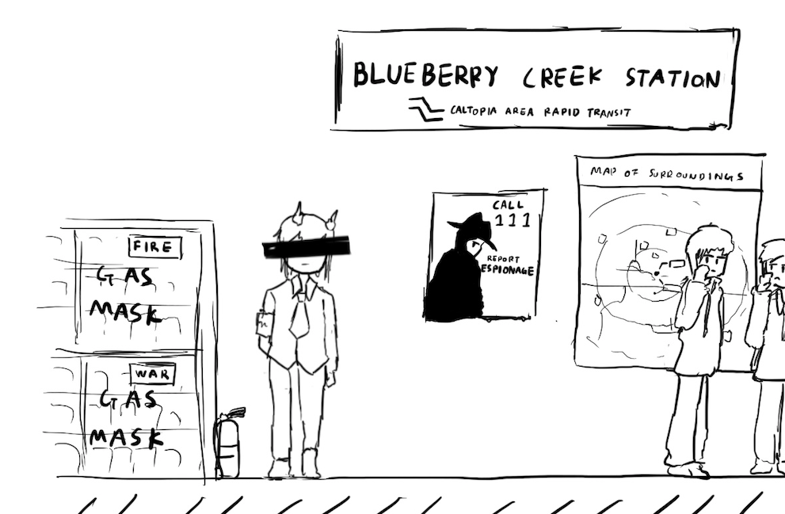
A Brief History of Cryptography
Textbook Chapter 5.2

Slide 65
Cryptography by Hand: Caesar Cipher
One of the earliest cryptographic schemes was the Caesar cipher
Used by Julius Caesar over 2,000 years ago
KeyGen():
Choose a key K randomly between 0 and 25
Enc(K, M):
Replace each letter in M with the letter K positions later in the alphabet
If K = 3, plaintext DOG becomes GRJ
Dec(K, C):
Replace each letter in C with the letter K positions earlier in the alphabet
If K = 3, ciphertext GRJ becomes DOG
K = 3
M | C | M | C
A | D | N | Q
B | E | O | R
C | F | P | S
D | G | Q | T
E | H | R | U
F | I | S | V
G | J | T | W
H | K | U | X
I | L | V | Y
J | M | W | Z
K | N | X | A
L | O | Y | B
M | P | Z | C

Slide 66
Cryptography by Hand: Attacks on the Caesar Cipher
Eve sees the ciphertext JCKN ECGUCT, but doesn’t know the key K
If you were Eve, how would you try to break this algorithm?
Brute-force attack: Try all 26 possible keys!
Use existing knowledge: Assume that the message is in English
+1 IBJM DBFTBS
+2 HAIL CAESAR
+3 GZHK BZDRZQ
+4 FYGJ AYCQYP
+5 EXFI ZXBPXO
+6 DWEH YWAOWN
+7 CVDG XVZNVM
+8 BUCF WUYMUL
+9 ATBE VTXLTK
+10 ZSAD USWKSJ
+11 YRZC TRVJRI
+12 XQYB SQUIQH
+13 WPXA RPTHPG
+14 VOWZ QOSGOF
+15 UNVY PNRFNE
+16 TMUX OMQEMD
+17 SLTW NLPDLC
+18 RKSV MKOCKB
+19 QJRU LJNBJA
+20 PIQT KIMAIZ
+21 OHPS JHLZHY
+22 NGOR IGKYGX
+23 MFNQ HFJXFW
+24 LEMP GEIWEV
+25 KDLO FDHVDU

Slide 67
Cryptography by Hand: Attacks on the Caesar Cipher
Eve sees the ciphertext JCKN ECGUCT, but doesn’t know the key K
Chosen-plaintext attack: Eve tricks Alice into encrypting plaintext of her choice
Eve sends a message M = AAA and receives C = CCC
Eve can deduce the key: C is 2 letters after A, so K = 2
Eve has the key, so she can decrypt the ciphertext

Slide 68
Cryptography by Hand: Substitution Cipher
A better cipher: create a mapping of each character to another character.
Example: A = N, B = Q, C = L, D = Z, etc.
Unlike the Caesar cipher, the shift is no longer constant!
KeyGen():
Generate a random, one-to-one mapping of characters
Enc(K, M):
Map each letter in M to the output according to the mapping K
Dec(K, C):
Map each letter in C to the output according to the reverse of the mapping K
K
M | C | M | C
A | N | N | G
B | Q | O | P
C | L | P | T
D | Z | Q | A
E | K | R | J
F | R | S | O
G | V | T | D
H | U | U | I
I | E | V | C
J | S | W | F
K | B | X | M
L | W | Y | X
M | Y | Z | H

Slide 69
Cryptography by Hand: Attacks on Substitution Ciphers
Does the brute-force attack still work?
There are 26! ≈ 2⁸⁸ possible mappings to try
Too much for most modern computers… for now
How about the chosen-plaintext attack?
Trick Alice into encrypting ABCDEFGHIJKLMNOPQRSTUVWXYZ, and you’ll get the whole mapping!
Another strategy: cryptanalysis
The most common english letters in text are E, T, A, O, I, N
K
M | C | M | C
A | N | N | G
B | Q | O | P
C | L | P | T
D | Z | Q | A
E | K | R | J
F | R | S | O
G | V | T | D
H | U | U | I
I | E | V | C
J | S | W | F
K | B | X | M
L | W | Y | X
M | Y | Z | H

Slide 70
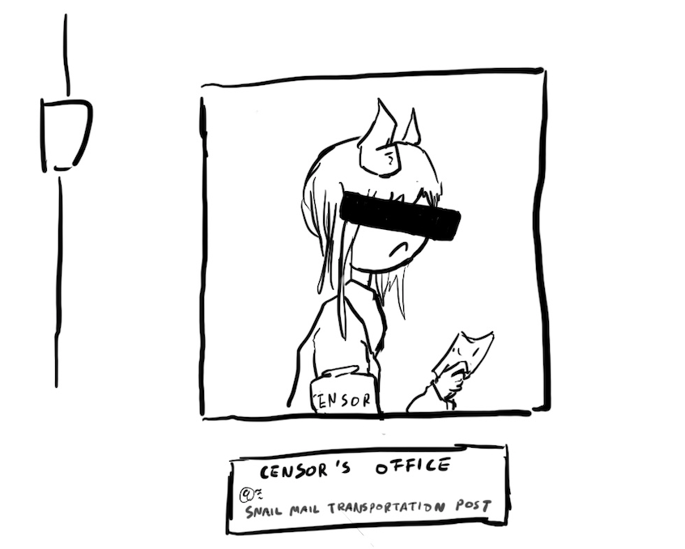
Takeaways
Cryptography started with paper-and-pencil algorithms (Caesar cipher)
Then cryptography moved to machines (Enigma)
Finally, cryptography moved to computers (which we’re about to study)
Hopefully you gained some intuition for some of the cryptographic definitions

Slide 71
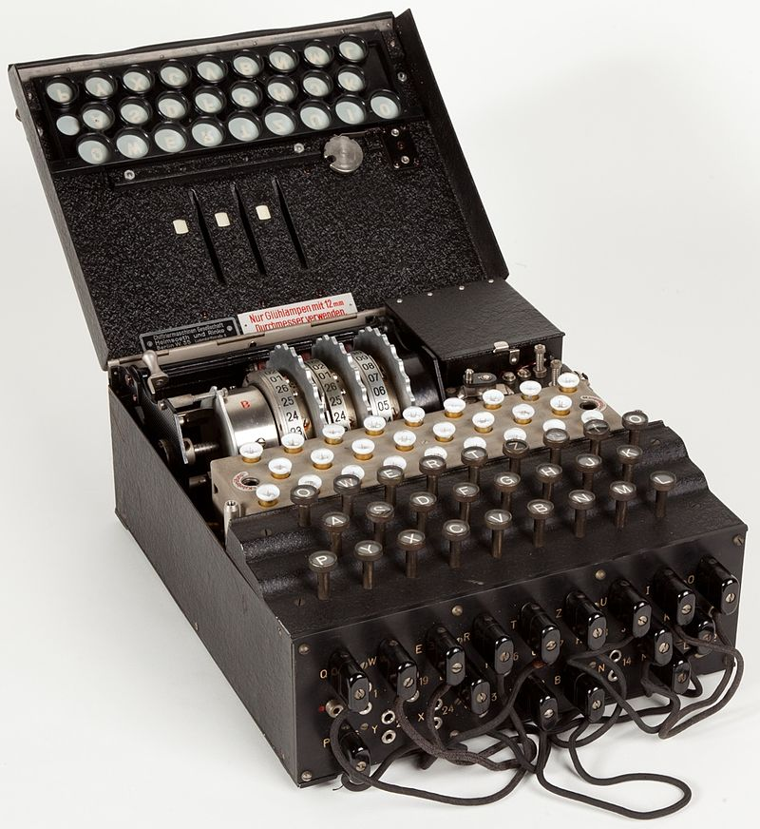

Cryptography by Machines: Enigma
A mechanical encryption machine used by the Germans in WWII
Rotors
Plugboard

Slide 72
Enigma Operating Principle: Rotor Machine
The encryption core was composed of 3 or 4 rotors
Each rotor was a fixed permutation (e.g. A maps to F, B maps to Q...)
And the end was a "reflector", a rotor that sent things backwards
Plus a fixed-permutation plugboard
A series of rotors were arranged in a sequence
Each keypress would generate a current from the input to one light for the output
Each keypress also advanced the first rotor
When the first rotor makes a full rotation, the second rotor advances one step
When the second rotor makes a full rotation, the third rotor advances once step

Slide 73
Cryptography by Machines: Enigma
KeyGen():
Choose rotors, rotor orders, rotor positions, and plugboard settings
158,962,555,217,826,360,000 possible keys
Enc(K, M) and Dec(K, C):
Input the rotor settings K into the Enigma machine
Press each letter in the input, and the lampboard will light up the corresponding output letter
Encryption and decryption are the same algorithm!
Germans believed that Enigma was an “unbreakable code”

Slide 74
Cryptography by Machines: Enigma
Eve (adversary)
Alice (challenger)
Enigma has a significant weakness: a letter never maps to itself!
No rotor maps a letter to itself
The reflector never maps a letter to itself
This property is necessary for Enigma’s mechanical system to work
What pair of messages should Eve send to Alice in the challenge phase?
Send M0 = A^{k}, M1 = B^{k}
M0 is a string of k 'A' characters, M1 is a string of k 'B' characters
How can Eve probably know which message Alice encrypted?
If there are no 'A' characters, it was M0
If there are no 'B' characters, it was M1
M
(repeat)
Enc(K, M)
M0 and M1
pick b
Enc(K, Mb)
M
(repeat)
Enc(K, M)
Guess b = 0 or b = 1

Slide 75
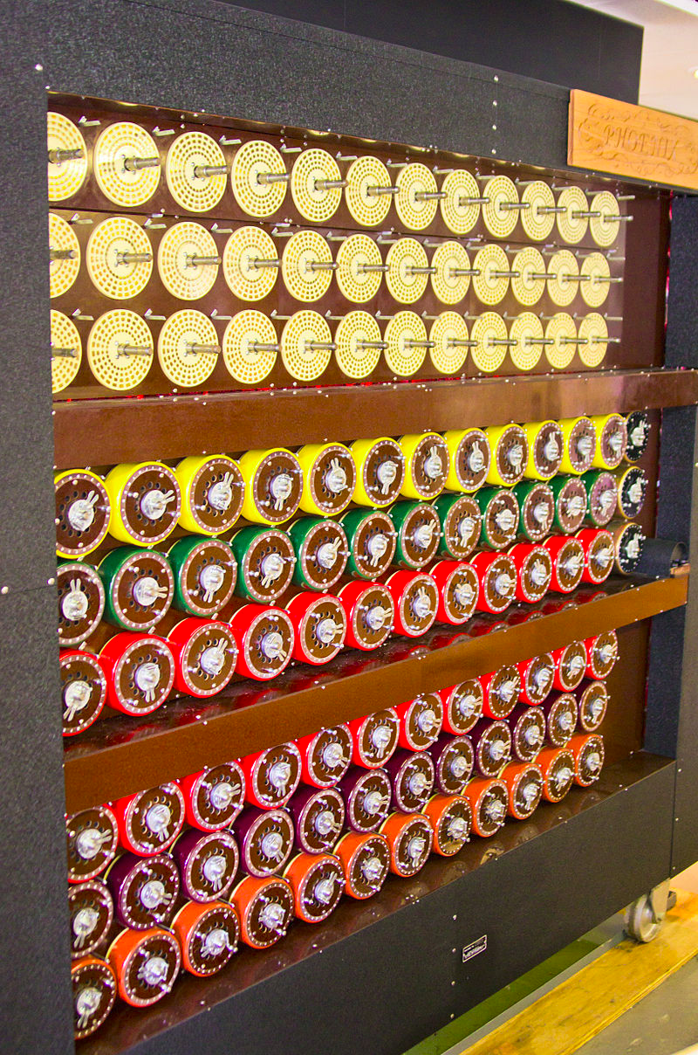
Cryptography by Machines: Attack on Enigma
Polish and British cryptographers built BOMBE, a machine to brute-force Enigma keys
Why was Enigma breakable?
Kerckhoff’s principle: The Allies stole Enigma machines, so they knew the algorithm
Known plaintext attacks: the Germans often sent predictable messages (e.g. the weather report every morning)
Chosen plaintext attacks: the Allies could trick the Germans into sending a message (e.g. “newly deployed minefield”)
Brute-force: BOMBE would try many keys until the correct one was found
Plus a weakness: You'd be able to try multiple keys with the same hardware configuration
BOMBE machine

Slide 76

Cryptography by Machines: Legacy of Enigma
Alan Turing, one of the cryptographers who broke Enigma, would go on to become one of the founding fathers of computer science
Most experts agree that the Allies breaking Enigma shortened the war in Europe by about a year
Alan Turing

Slide 77


Cryptography by Computers
The modern era of cryptography started after WWII, with the work of Claude Shannon
“New Directions in Cryptography” (1976) showed how number theory can be used in cryptography
Its authors, Whitfield Diffie and Martin Hellman, won the Turing Award in 2015 for this paper
This is the era of cryptography we’ll be focusing on
One of these is Diffie, and the other one is Hellman.

